Slide 1
The Impact of Covid 19
In regards to drug abuse and overdose trends (2019-2024)

Slide 2
Various types of data reflecting in finance, healthcare and surveys.
Surveys
Healthcare
Finance

Slide 3
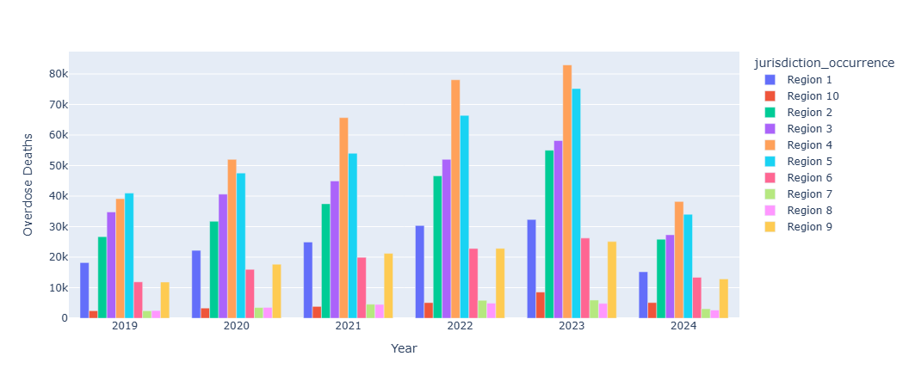
CDC Results of overdose by year.

Slide 4
Temporal Trend:
In the section we will show how drug overdose death rates change before and after the COVID-19 pandemic.
2.Disclosing the specific time period during the pandemic where overdose death peaked.

Slide 5
Geographic Analysis:
1.In this section we will differentiate the states or regions that experienced the highest increases in overdose deaths post-COVID.
2.Continuing analysis to see if there are any geographic patterns associated with changes in overdose rates.

Slide 6
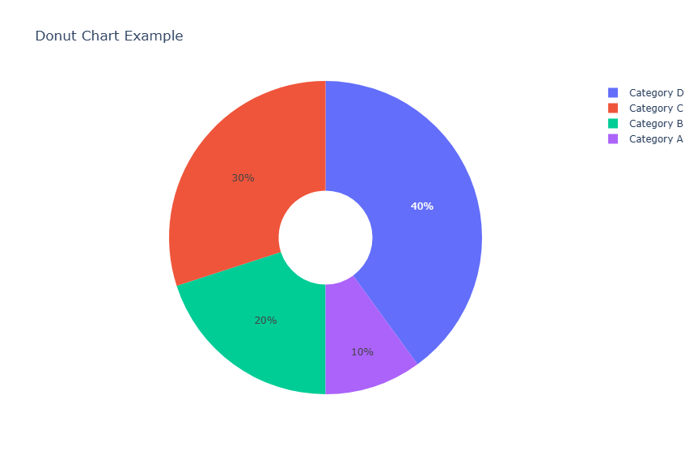
Overdose by Various Drug Types

Slide 7
Demographic Insights:
1. Were certain of the various demographic groups have disproportionately been affected by overdose deaths post-COVID such as.
2.Releating how these changes compare to pre-COVID trends.

Slide 8
Substance-Specific Trends:
Here we disclosed the data to showing if the substances involved in overdose deaths shift during the pandemic.
If so the synthetic drugs, such as fentanyl, play in post –COVID overdose rates.

Slide 9
Correlations with Pandemic Factors:
Here we discuss overdose death trends correlated with pandemic – related factors such as-.
1. Unemployment rates
2. Lockdown policies
3 Mental health services

Slide 10
Referenced Data Sources
Centers for Disease Control and Prevention (CDC):
https://data.cdc.gov/NCHS/VSRR-Provisional-Drug-Overdose-Death-Counts/xkb8-kh2a/about_data
Centers for Disease Control and Prevention (CDC):
https://data.cdc.gov/NCHS/Provisional-drug-overdose-death-counts-for-specifi/8hzs-zshh/data_preview

